Slide 1


Presentation

Slide 2
Digital portfolio
NAME: PRIYADHARSHINI.S
REG.NO: 24131241802522024
NMID:D8234606C3EB916B4CB4C072C1014D98
DEPORTMENT:BSC COMPUTER SCIENCE COLLEGE:GOVERNMENT ARTS AND SCIENCE COLLEGE, VADALUR

Slide 3
STUDENT DIGITAL PORTFOLIO
Interactive Digital portfolio
using canva

Slide 4
AGENDA
PROBLEM STATEMENT
PROJECT OVERVIEW
EMAIL USERS
TOOLS & TECHNOLOGIES
PORTFOLIO DESIGN & LAYOUT
FEATURES & FUNCTIONALLY
RESULTS & SCREENSHOT
CONCLUSION

Slide 5
PROBLEM STATEMENT
problem statement is a clear and concise description of
an issue that needs to be addressed

Slide 6
PROJECT OVERVIEW
project overview is a concise, single-document summary
of a project's core components, including its purpose,
goals, objectives, timeline, budget, resources, and key
deliverables

Slide 7
END USER
Your STUDENTS
MY RESUME:
NAME: S. PRIYADHARSHINI
AGE: 18
FATHER'S NAME: SELVAM
KNOWS OF PROGRAMMING LANGUAGE: PYTHON, C, C++, JAVA, HTML,
CSS, JS, SQL
CONTACT MAIL ID:
srpriya2986@gmail.com text

Slide 8
I am a very sincere to work and
depth program knowledge....
Thank you
Your SINCERELY
PRIYADHARSHINI

Slide 9
NEAT PROFESSIONAL
Are seeing profile and resume..

Slide 10
TOOLS & TECHNOLOGIES
HTML-TAG & STRUCTURES
CSS-STYLING PROPERTY
JS-INTERACTIVITY
EDITOR-CODEPEN

Slide 11
PORTFOLIO DESIGN &
LAYOUT
PORTFOLIO DESIGN &
LAYOUT
ABOUT ME
ACHIEVEMENT
CONTACT
SKILLS
INTERACTIVITY
WORKING (MOBILE)

Slide 12
FEATURES & FUNCTIONALIT
NAVIGATION BAR
RESPONSIVE DESIGN FOR ALL DEVIC
INTERACTIVE ELEMENTS
SMOOTH SCROLLING

Slide 13
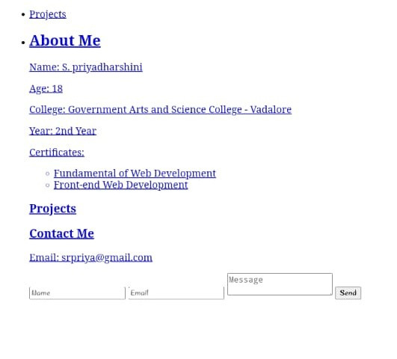
RESULT & SCREENSHORT

Slide 14
CONCLUSION
I AM REALLY EXCITED TO CREATE MY OWN
PPT FOR NAAN MUDHALVAN..

Slide 15
THANK YOU

